Slide 1
Mechanical
Integrator
CSCE 462: Alex Akomer & Shaheen Ebrahimi

Slide 2
PROJECT GOALS
When we set out to build this project, we wanted to:
Create a visualization tool that will allow us to solve integrals in a comprehensible way
Create a sleek, modular design for better testing
Better grasp concepts of mechanical and electrical design from the perspective of primarily computer science students

Slide 3
SYSTEM DESIGN
STEP 1
STEP 2
STEP 3
STEP 4
TIME DISK
PULLEY
FOLLOWER
CIRCUITRY
Building the payload, attaching the DC motor
Constructing the linear motion system to pull the payload
Attaching a wheel to an encoder placed on rotating time disk
Soldering together all previous components

Slide 4
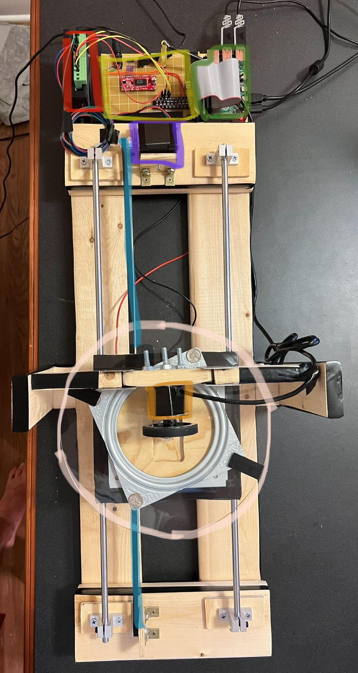
PARTS USED
Raspberry Pi 4
DC Motor + Disk
Stepper Motor
Stepper Motor Driver
Pulley Belt
Encoder + Disk
Perf board (PCB board)
Wooden beams

Slide 5
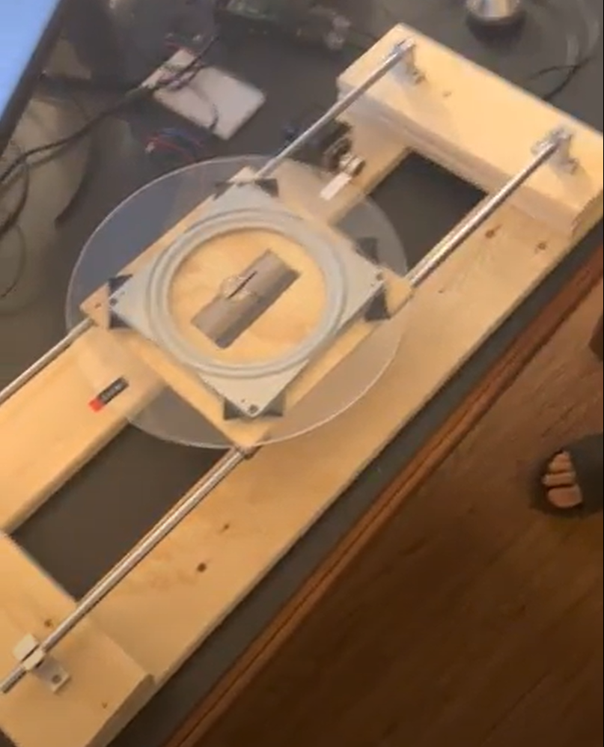
CONSTRUCTION

Slide 6
CONSTRUCTION
Requirements
Must be sturdy and structurally sound to support pulses from stepper motor
Process
Measured out pieces with rulers and planned out structure
Used hand saws to cut pieces of wood to for components and assembled with screws and Gorilla Glue
Complications
Didn’t have appropriate tools to cut or screw in all mechanical portions
Real-world issues that were not considered (ex: wood splintering and measuring holes)

Slide 7
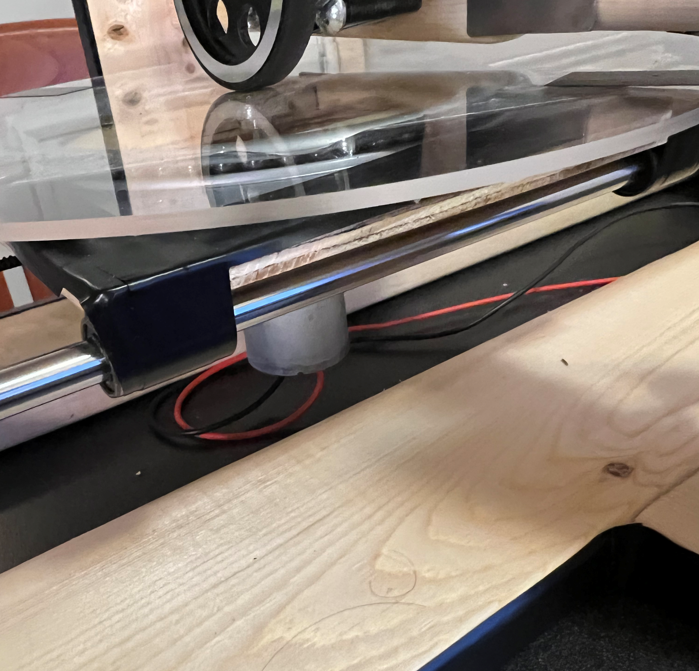
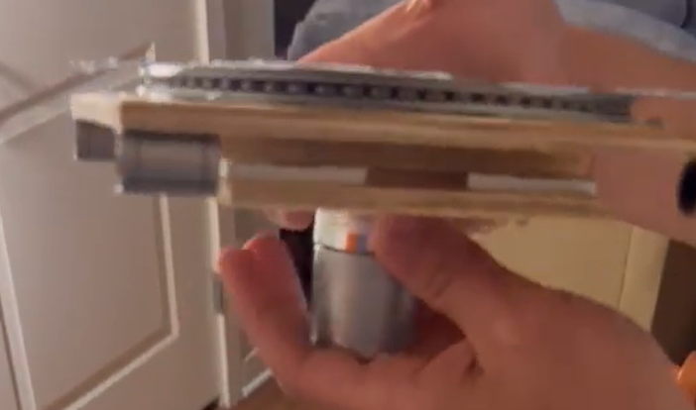
TIME DISK

Slide 8
TIME DISK
Requirements
Must move along a linear track smoothly and have a DC motor that spins a disk attached
Process
Used hand saws to cut pieces of wood to for components and assembled with screws and Gorilla Glue
Attached ball bearing housings for linear slides by lining up linear motion rods
Attached lazy-susan bearing to support disk and spin freely
Added overhang beneath payload to attach pulley in future
Complications
Original DC motor didn’t deliver enough torque to spin disk - needed a replacement

Slide 9
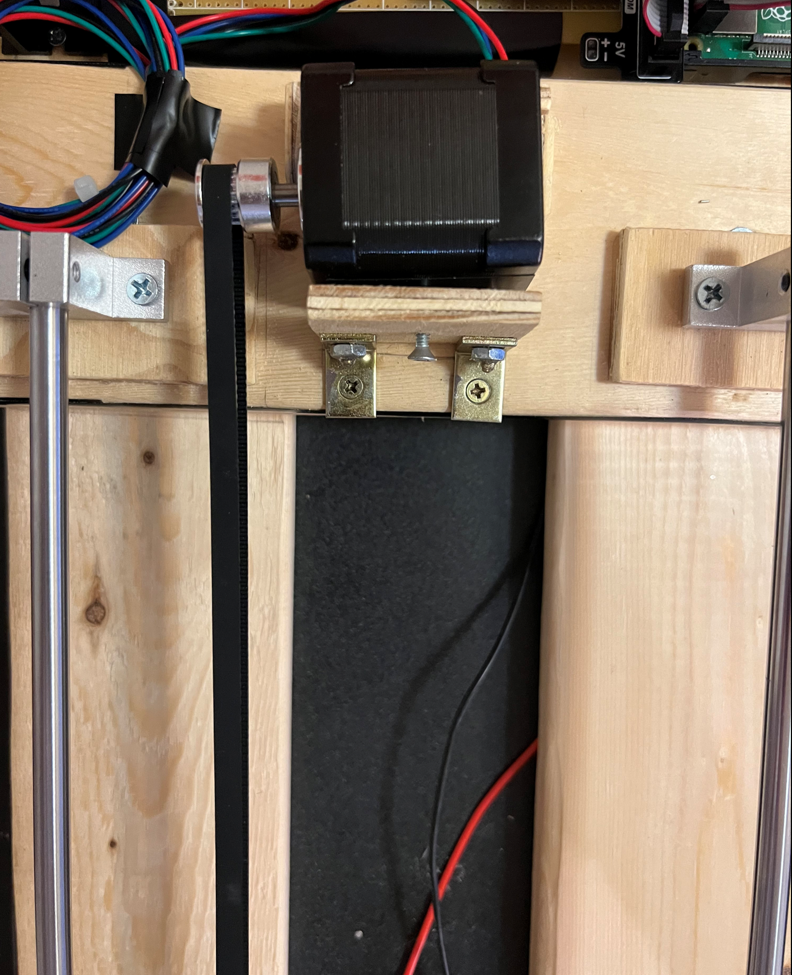
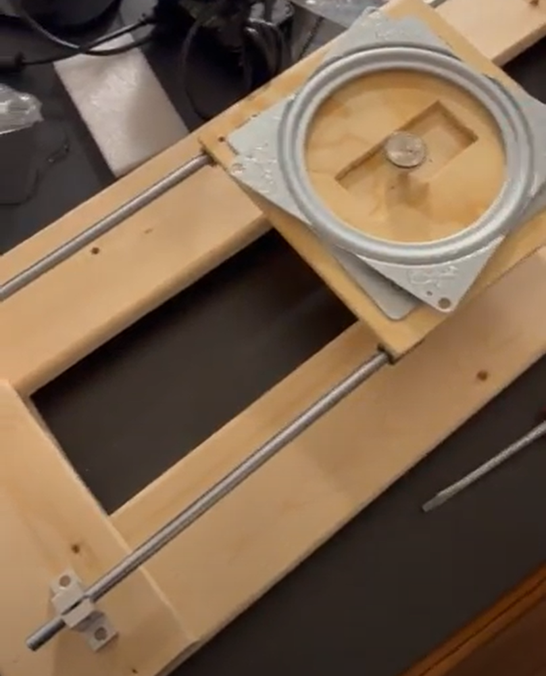
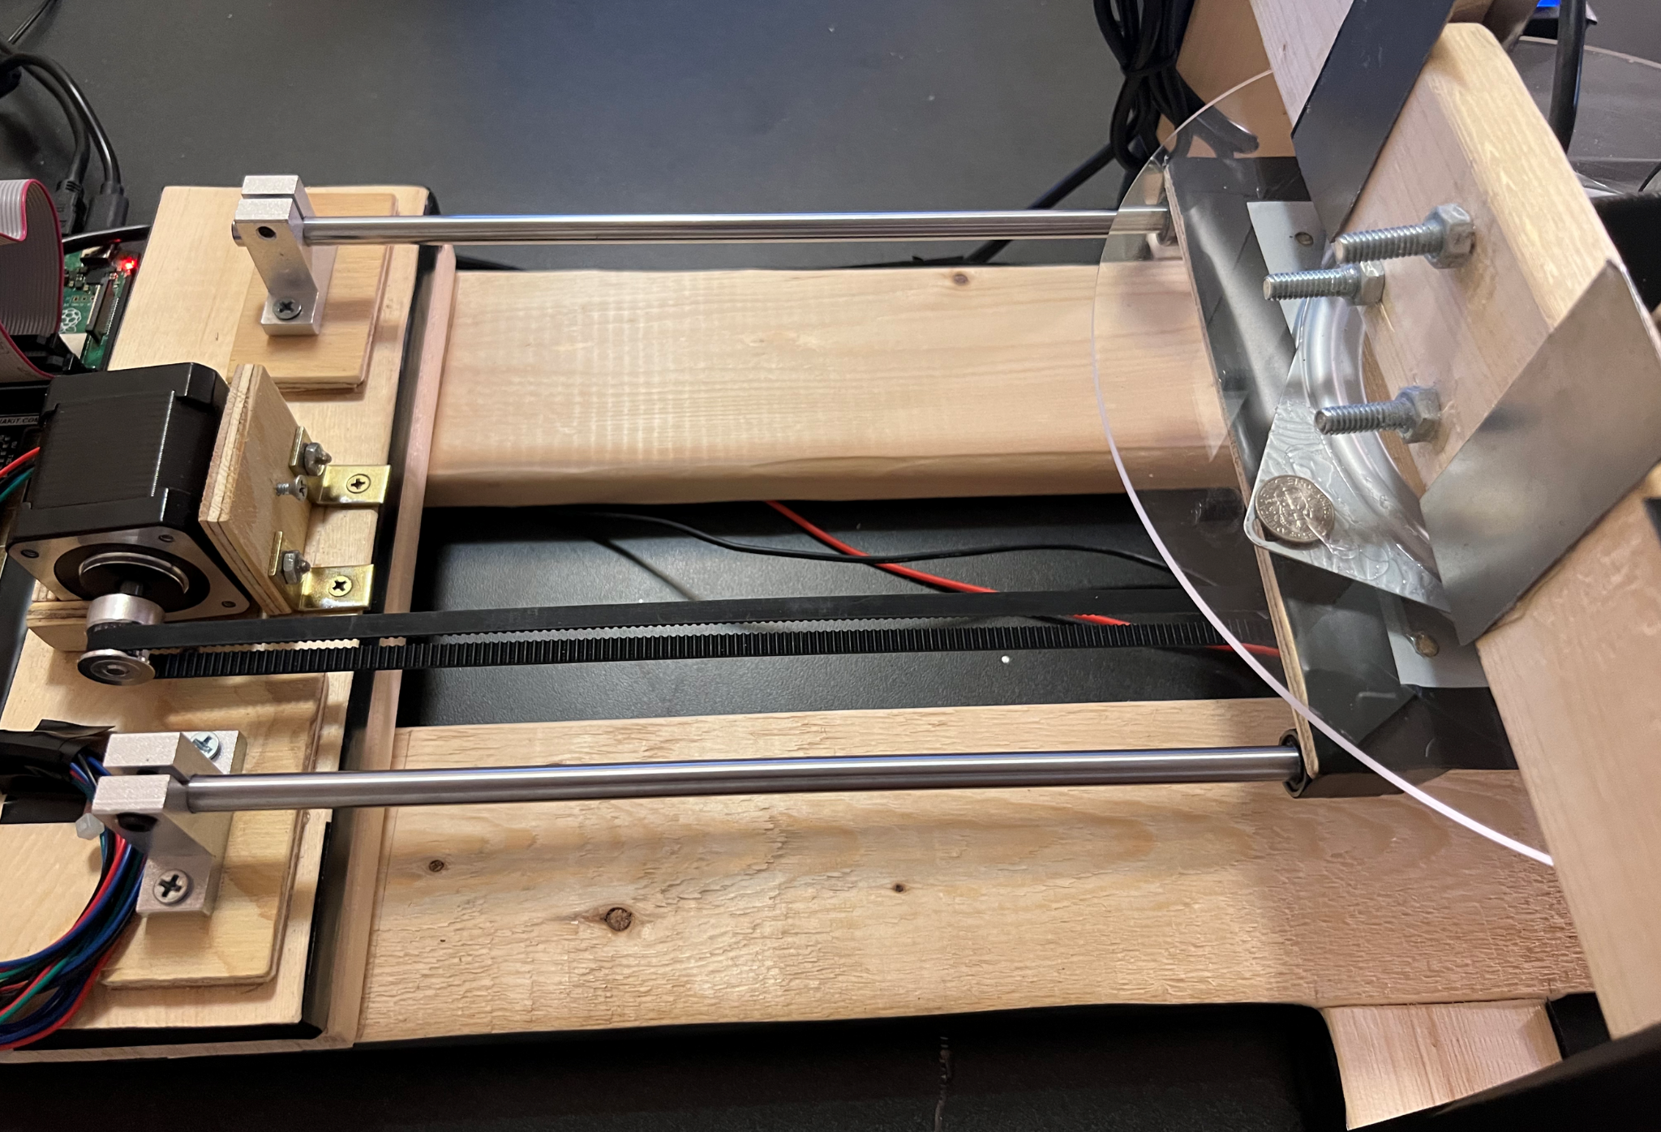
LINEAR MOTION

Slide 10
LINEAR MOTION
Requirements
Move the payload with ease and high accuracy and easy disassembly and reassembly
Process
Unit tested the stepper motor to make sure we knew how to control it
Created a modular frame for stepper motor that allowed easy mounting and dismounting
Created a static end of pulley system on other end by placing a screw through wood
Measured and attached a pulley belt to mounting bracket on the payload
Complications
Stepper motor driver got fried when plugging in GPIO band into Raspberry Pi at one point so needed to order a new one, which halted progress

Slide 11
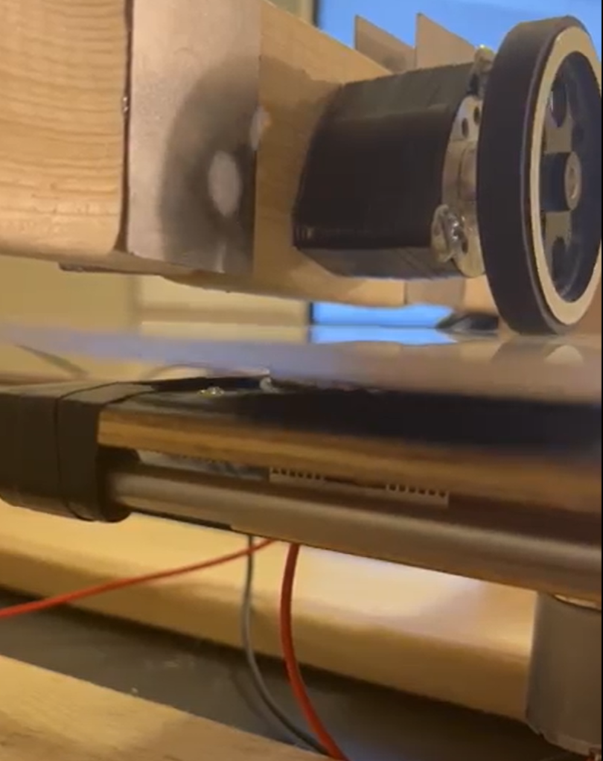
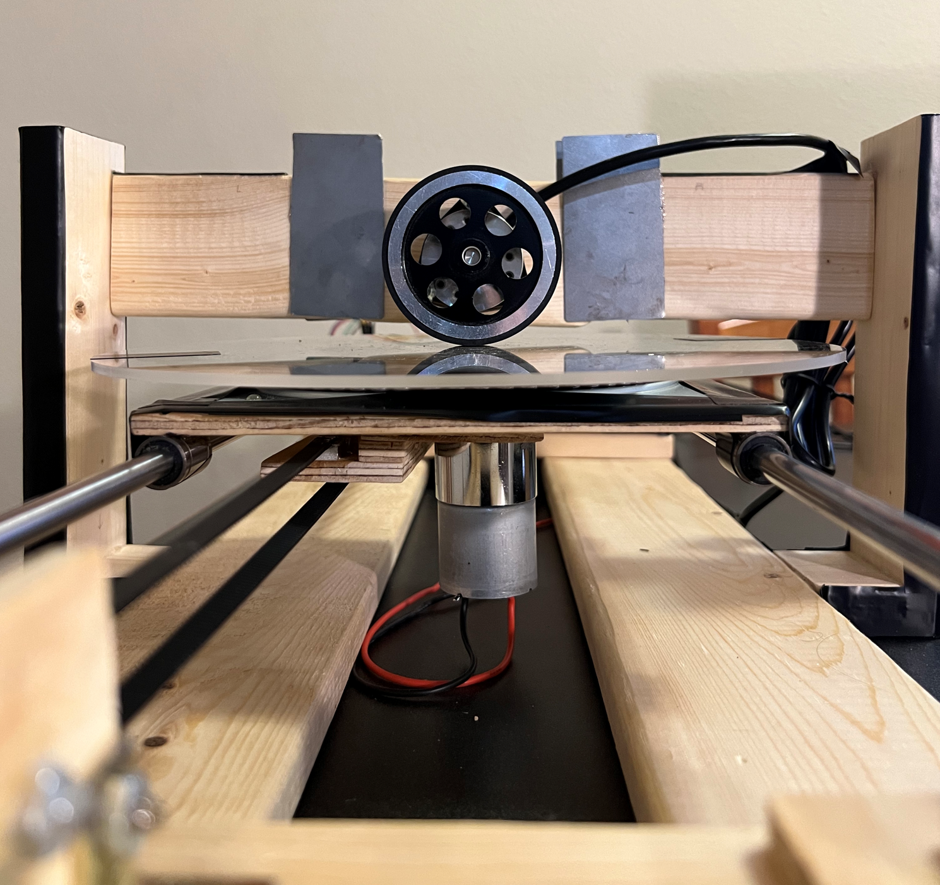
FOLLOWER DISK

Slide 12
FOLLOWER DISK
Requirements
Must rest perfectly on top of the time disk and be able to slide and spin freely
Process
Created a wood frame which was attached to the rest of the body
Secured the encoder with three large machine screws surrounding it in a triangular pattern
Set up a sliding mechanism so the follower disk could maintain contact with the time disk
Complications
Time disk was not level so the encoder didn’t make contact at all points
Sliding mechanism got caught frequently - solution: sand down corners
Weight of encoder would torque sliding portion - solution: counterweight

Slide 13
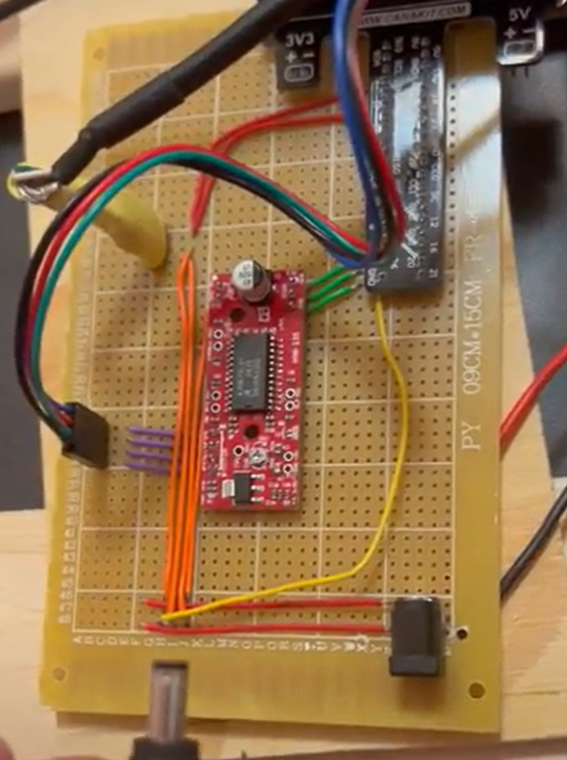
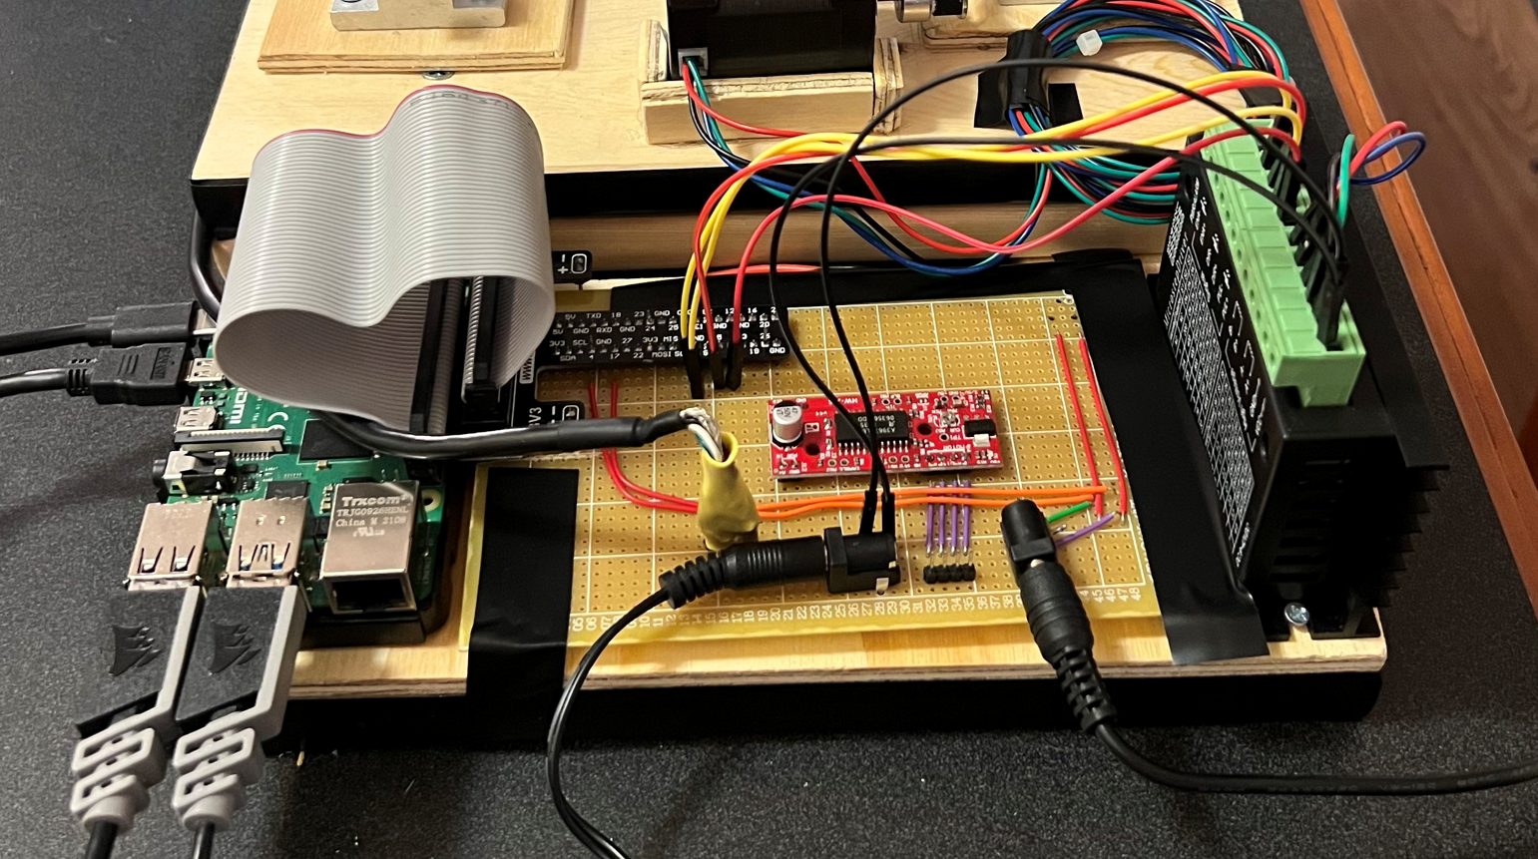
CIRCUITRY

Slide 14
CIRCUITRY
Requirements
Wire the DC motor, stepper motor (and driver), and encoder together to be controlled by running a single script
Process
Tested each peripheral separately before to ensure success
Design layout to properly connect each peripheral to GPIO pins and conserve PCB space
Soldered each piece down - redid portions with new stepper motor driver
Complications
Lack of experience with soldering.
Misinput burnt stepper motor driver, had to reorder new part (original was out of stock)
Assumption that isolated tests would behave like full system tests (insufficient amperage)

Slide 15
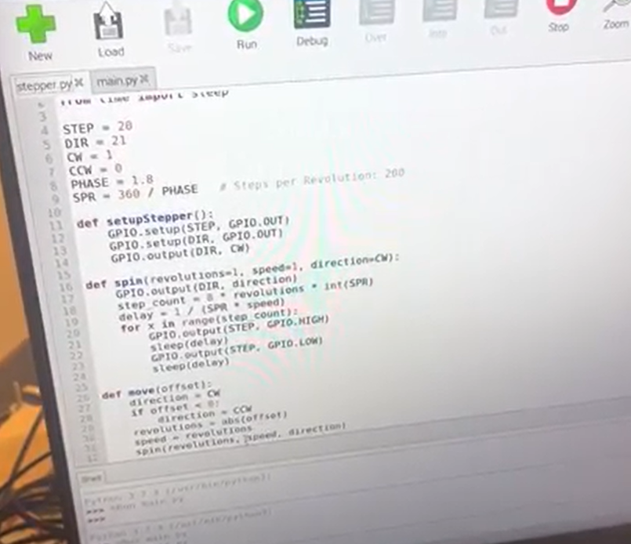
SOFTWARE
GitHub Link

Slide 16
SOFTWARE
Requirements
Control stepper movement based on y-values of input function to calculate integral
Process
Get all components independently working properly (encoder was working at this point)
Calculate how many steps each sample needs to take
Calculate speed of samples by getting elapsed time w.r.t speed for all number of steps and then plotting/finding best fit curve for desired time delta (0.25s per sample)
Complications
Encoder had trouble working with GPIO library so switched to pigpio
Finding the speeds for each set of steps so they would all take the same amount of time
Encoder ended up being broken after wondering why output completely wrong

Slide 17
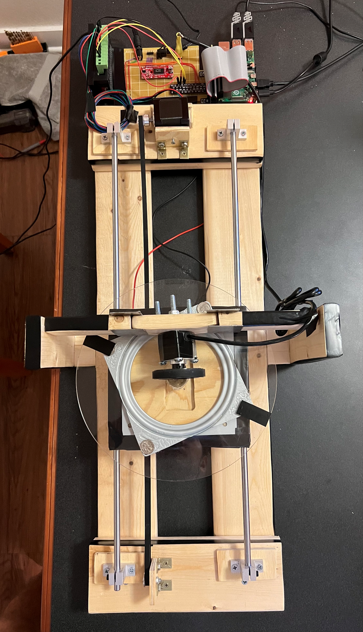
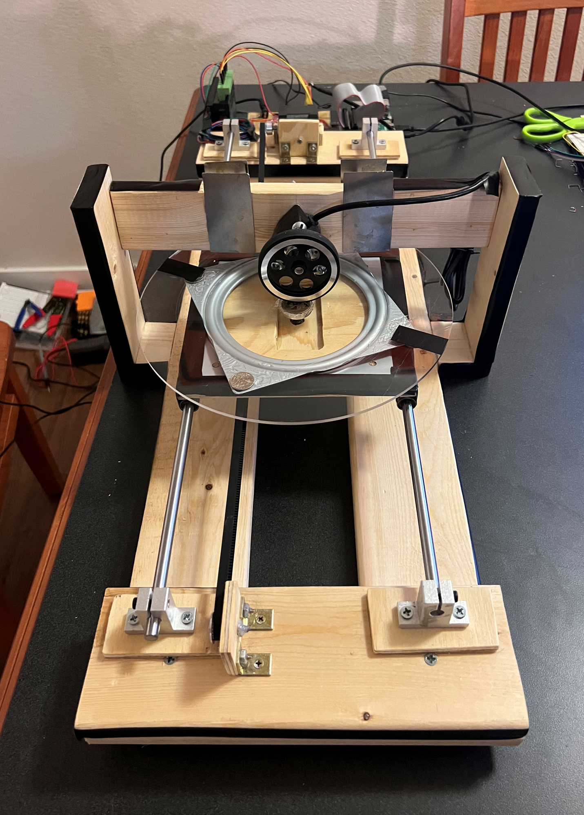
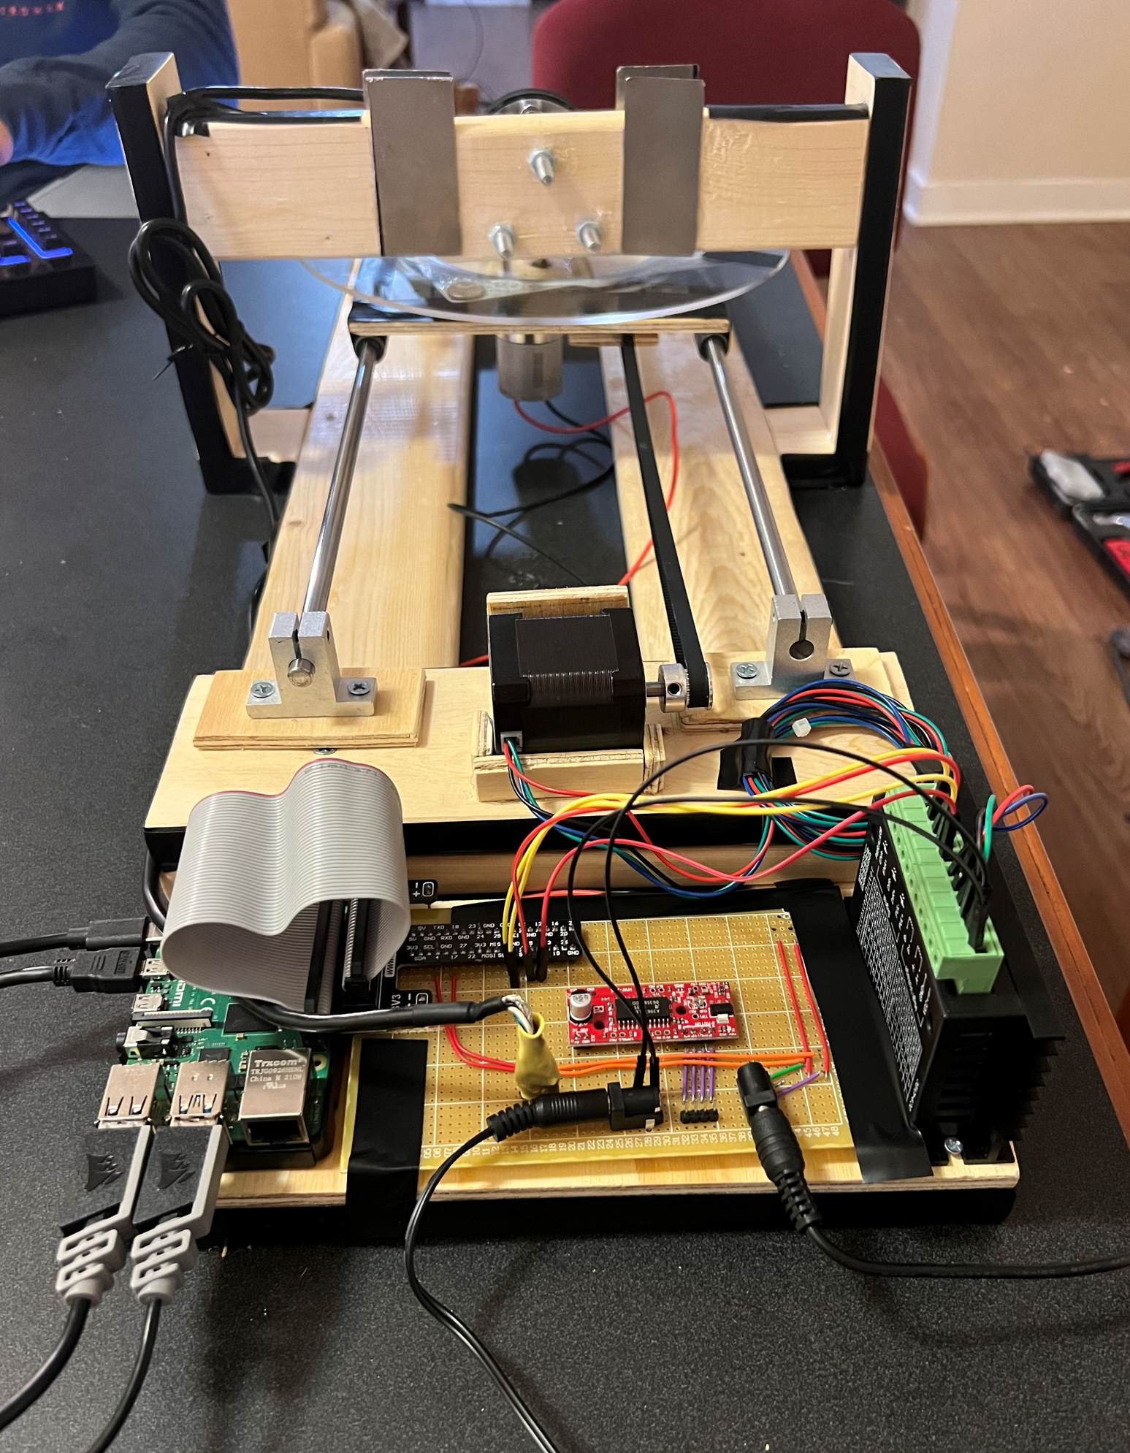
FINAL PRODUCT
Output Shaft
Encoder
Follower Disk
Pulley
Time Disk
y
Stepper Motor
DC Motor
Linear Motion Track

Slide 18
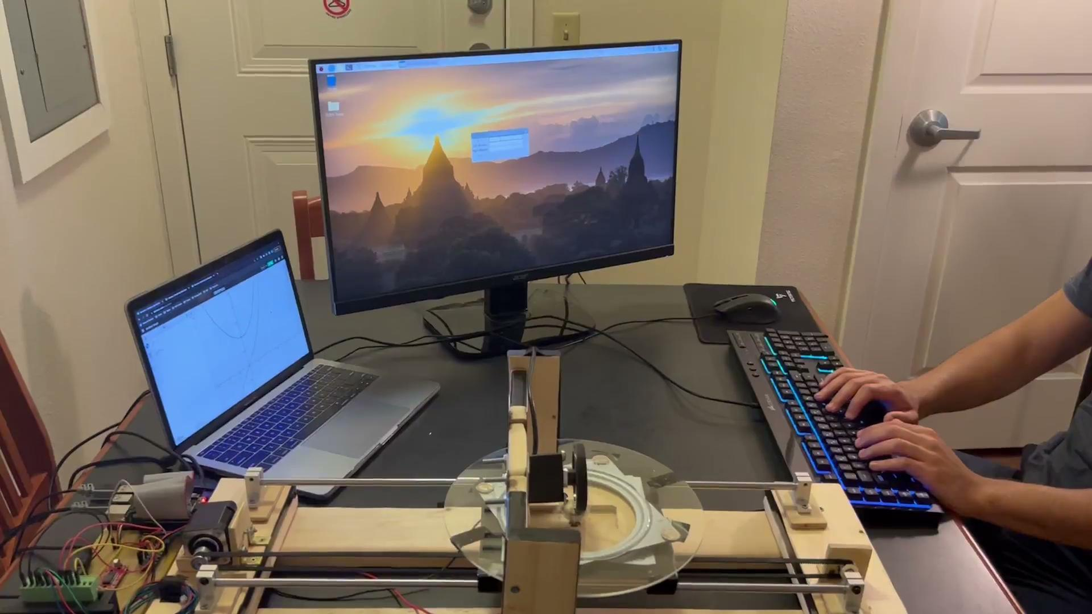

VIDEO OF FINAL PRODUCT
Final Demo
Sine Wave Bonus Angle

Slide 19
CHALLENGES & CONCLUSION
Challenges:
Inexperience with electrical design process led to failure of several key components on tight timeframe
Lack of technical knowledge in creating a mechanical design led to mismeasured components and many redoes
Small initial miscalculations for parts ordered online led to delays and many incurred costs
Conclusion:
Project was largely beneficial in teaching mechanical and electrical design concepts and cautions
Project is fully functional given a replacement encoder
Became a passion project that > 100 hours were invested in and personal time lapses were taken of

Slide 20
THANK YOU!
alexakomer@tamu.edu & shaheenebrahimi@tamu.edu

